Slide 1


LCD- 16x2 character display Term Research Project
By: Paul Kafka

Slide 2
Project Description
FPGA-based NIOS II system designs of your choice
Task:
“Program to implement custom
characters like different smiley faces.”

Slide 3
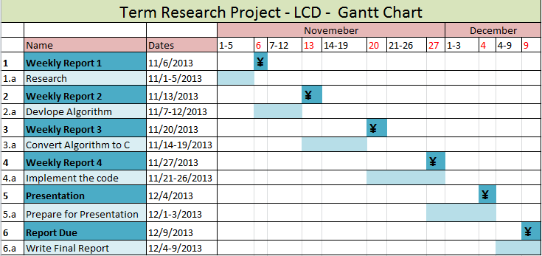
Approach

Slide 4
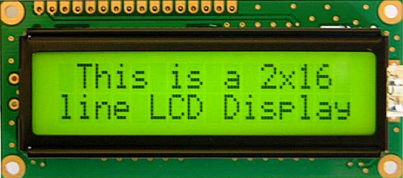
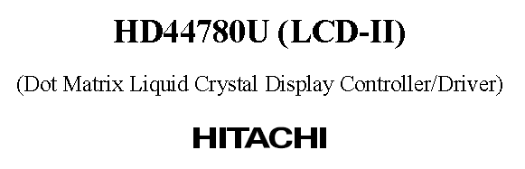
Research
LCD – Liquid-Crystal Display. Light modulating properties of liquid crystals.
The Character LCD Core sends characters to the LCD according to the Character Generator ROM Pattern of the LCD
The LCD Core supports a clock frequency of 50 MHz.

Slide 5
SOPC Builder +Media Computer + Nios + Monitor Program +HAL
SOPC Builder – Instantiates the Character LCD Core component which supports the Nios II processor.
Altera Nios II processor – A 32-bit CPU that can be instantiated in an Altera FPGA chips, and some simple I/O peripherals.

Slide 6
SOPC Builder +Media Computer + Nios + Monitor Program +HAL
Media Computer –The system contains a processor and memory. includes the Nios II version and a (LCD) port that is connected to the 16x2 character display on the DE2 board.
LCD display port automatically initializes and conﬁgures display when the DE2 Media Computer is reset.
Used the media.c as a starting point.
HAL system library drivers - Enables you to access the LCD controller using the ANSI C standard library functions for the Nios processor.
Altera Monitor Program – An easy way to begin working with the DE2 Media Computer and the Nios II processor. Assemble/compile Nios II programs that are written in either assembly language or the C language

Slide 7
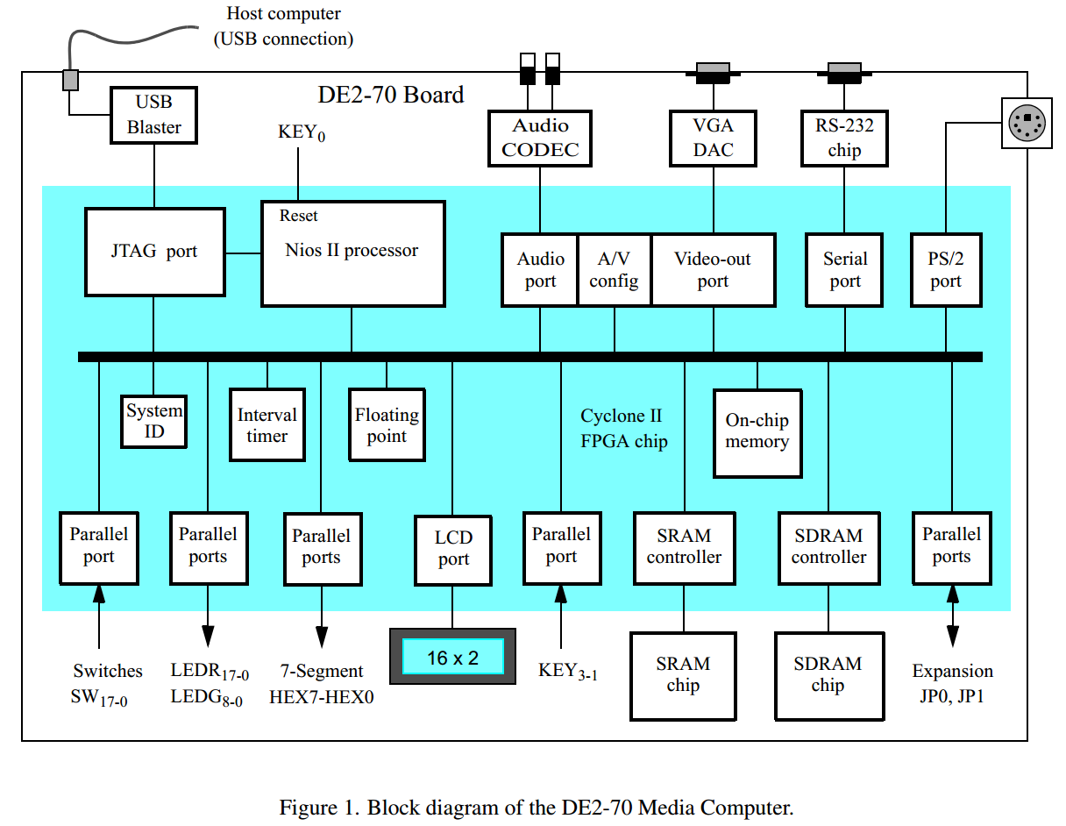
DE2 Media Computer

Slide 8
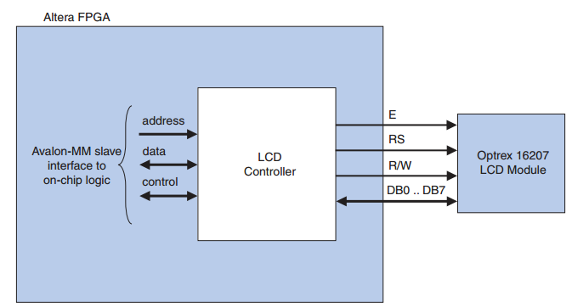
LCD Controller Block Diagram

Slide 9
LCD Control
Data can be sent to the display as ASCII character codes, which are automatically converted by the 16x2 character display into bit patterns using a built-in font.
After the location of the cursor has been set, a character can be loaded into this location by writing its ASCII value into the Data register.
As characters are written, the cursor position is updated.
The LCD controller is an output-only device.

Slide 10
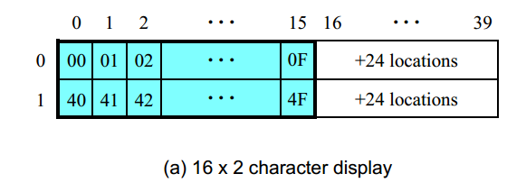
LCD Byte by Byte

Slide 11
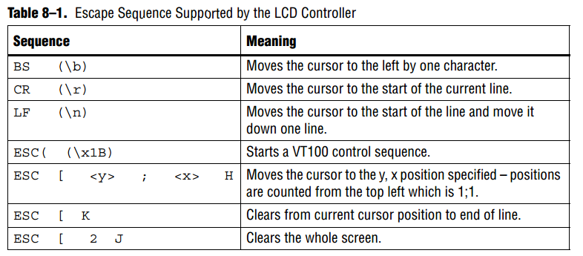
Escape Characters
The LCD driver supports a small subset of ANSI and VT100 escape sequences that can be used to control the cursor position, and clear the display.

Slide 12
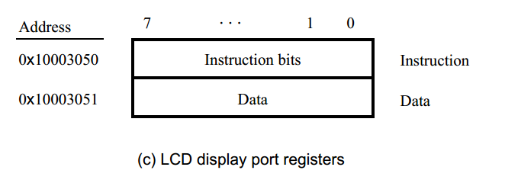
Register Map
Two 8 bit registers
Instruction register (IR) – Used to control the 16x2 character display.
Data register (DR) –Used to send character data to the display
The HAL device drivers make it unnecessary for you to access the registers directly. Therefore, Altera does not publish details about the register map.
altera_avalon_lcd_16207_regs.h is given but it’s implementation file isn’t.

Slide 13
3 Types Memory
DD RAM – Display Data RAM
8 bit character codes
CG ROM or CG RAM loaded in DD RAM when needed for display
CG ROM – Character Generator ROM
Generates 5x8 dot character patterns from the character codes. User-defined character patterns are also available by mask-programmed ROM.
CG RAM – Character Generator RAM
Can be rewritten patterns.
Few locations available

Slide 14
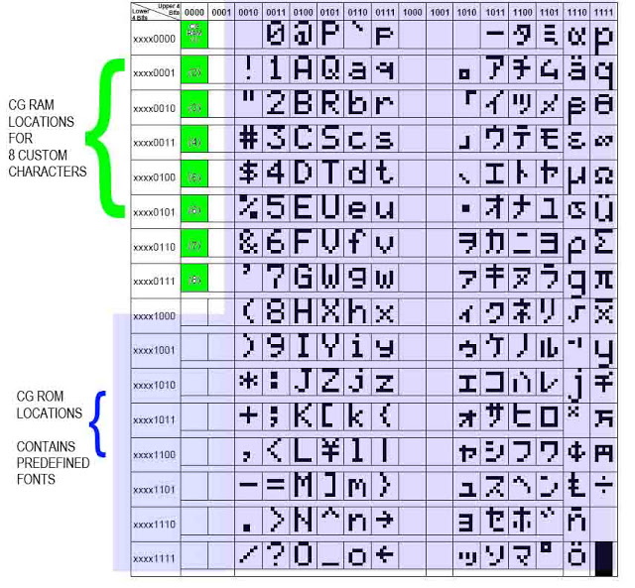
Modifying Character Patterns
Steps.
Load data to CG Ram
Load the CG Ram data
into DD RAM.

Slide 15
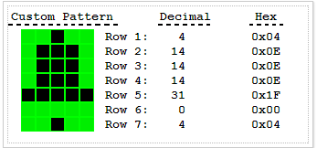
Custom Pattern Data

Slide 16
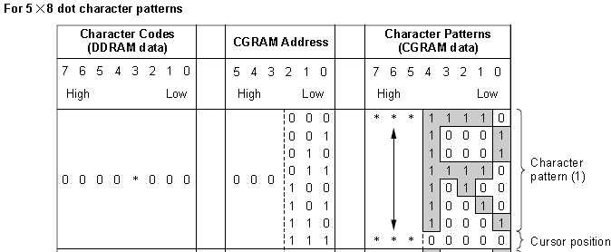

Slide 17
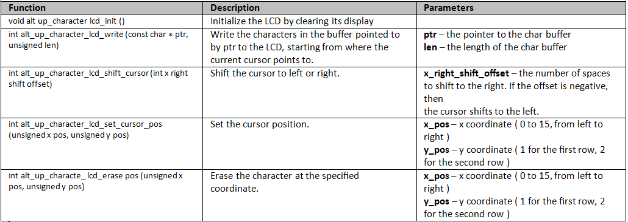
LCD Functionality
#include “alt_up_character_lcd.h”

Slide 18
Software Files
The LCD controller is accompanied by the following software files. These files define the low-level interface to the hardware and provide the HAL drivers. Application developers should not modify these files.
BSP>drivers>inc
BSP>drivers>src
altera_avalon_lcd_16207_regs.h — This file defines the core's register map, providing symbolic constants to access the low-level hardware.
altera_avalon_lcd_16207.h, altera_avalon_lcd_16207.c — These files implement the LCD controller device drivers for the HAL system library
system.h – Has LCD Configurations

Slide 19
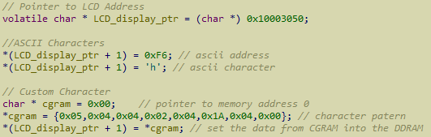
Example Code

Slide 20
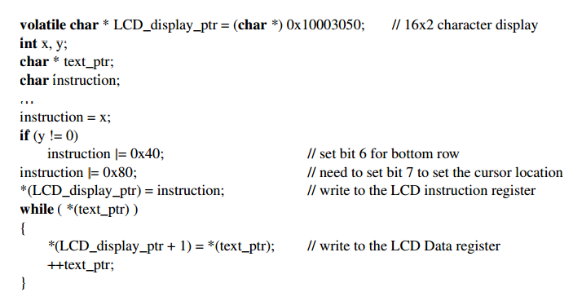
Example Code

Slide 21
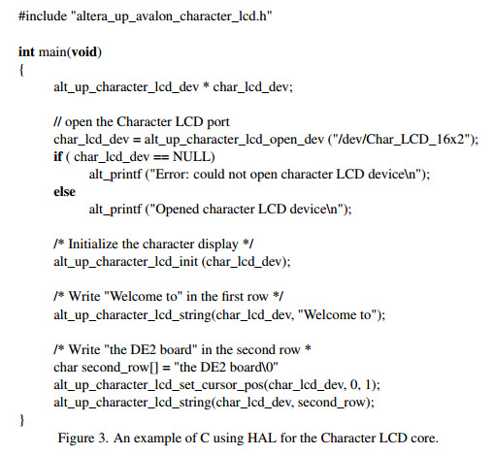
Example Code

Slide 22
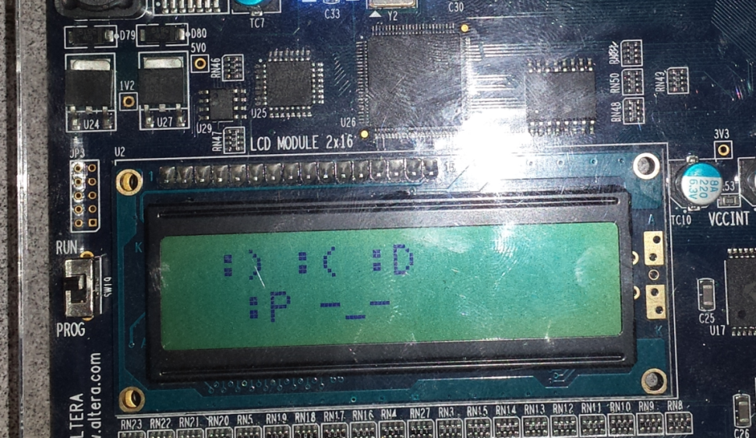
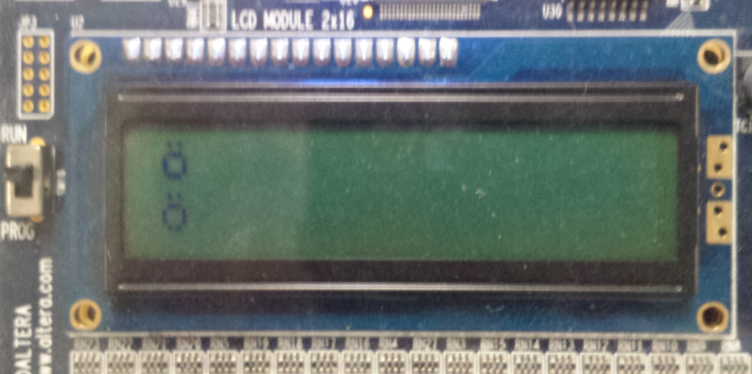
Outcome

Slide 23
Questions?

